Slide 1

SENTIMENT ANALYSIS on
Chinese SmartPhones’ Review
Presented by: GROUP 4
Aastha Aggarwal (PGDM) - 19PGDM002
Abhinandan Jain (PGDM) - 19PGDM004
Ritu Mittal (PGDM) - 19PGDM052
Raja Shrikrishnan (PGDM) -19PGDM050
Souvik Samanta (PGDM) - 19PGDM064

Slide 2
Agenda
01 PROBLEM STATEMENT
02 METHODOLOGY
03 ANALYSIS AND INTERPRETATIONS
04 QUERIES
NALYSIS- SENTIMENT

Slide 3
“
Problem Statement
Analysis on reviews of MI Phones to understand the sentiments of people about the phone
“
NALYSIS- SENTIMENT

Slide 4
Methodology
Data is unnested into words and sentiments are derived
Examine the data by creation of dtm-matrix, n-grams and word cloud
Preliminary look at the data for removing stopwords and removing irrelevant data
04
Sentiment Analysis
Scrapping the data from Flipkart regarding reviews on MI phones
03
Tokenization, Word Cloud and N-gram Analysis
02
Data Cleaning
01
Data Scraping

Slide 5

01
Data Scraping

Slide 6
Preliminary look at Data Scraping and Extraction
# Defining scraper function
scrape <- function(url){
flk <- read_html(url)
flk %>% html_nodes("[class='_2xg6Ul']") %>% html_text() %>% gsub("[^\x01-\x7F]", "", .) -> ttl
flk %>% html_nodes("[class='qwjRop']") %>% html_text() %>% gsub("READ MORE", "", .) %>% gsub("[^\x01-\x7F]", "", .)-> rv
rvw <- data.frame("Title" = ttl, "Review" = rv)
return(rvw)
}
# Defining blank data frame for capturing data
rvw_master <- data.frame(Title=character(), Review=character())
#--------------------------------------------------------------------------------------------------------------------------------------------------------------------------
url <- c()
for (i in seq(1,5)){
ur <- paste("https://www.flipkart.com/mobiles/mi~brand/pr?sid=tyy%2
C4io&otracker=nmenu_sub_Electronics_0_Mi&page=",i) %>% gsub(" ", "", .)
url <- c(url,ur)
}
url_list <- c()
for (i in url)
{
flk <- read_html(i)
ff <- flk %>% html_nodes("[class='_31qSD5']") %>%
html_attr("href")
j <- 1
nn <- c()
for (i in ff)
{
nn[j] <- paste("https://www.flipkart.com",i) %>% gsub(" ", "", .)
j <- j + 1
} ; url_list <- c(url_list, nn)
# Running scraper
for (i in url_list){
rvw_master <- rbind(rvw_master,scrape(i))}
write.csv(rvw_master, "MIReviews.csv", row.names = FALSE)

Slide 7
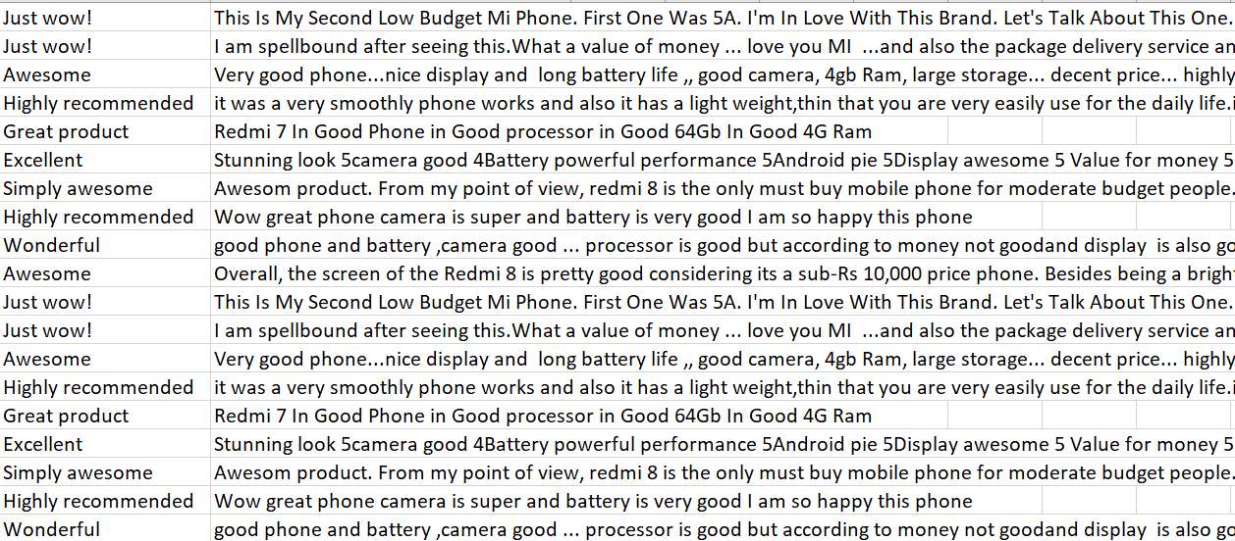
EXTRACTED DATA

Slide 8
02
Data Cleaning

Slide 9
DATA CLEANING
docs <- VCorpus(VectorSource(textdata$Review))
View(docs)
#Text transformation
toSpace <- content_transformer(function (x , pattern ) gsub(pattern, " ", x))
docs <- tm_map(docs, toSpace, "/")
docs <- tm_map(docs, toSpace, "@")
docs <- tm_map(docs, toSpace, "\\|")
#Cleaning the text
# Convert the text to lower case
docs <- tm_map(docs, content_transformer(tolower))
# Remove numbers
docs <- tm_map(docs, removeNumbers)
# Remove english common stopwords
docs <- tm_map(docs, removeWords, stopwords("english"))
# Remove punctuations
docs <- tm_map(docs, removePunctuation)
# Eliminate extra white spaces
docs <- tm_map(docs, stripWhitespace)
for(i in 1:100){
writeLines(as.character(docs[[i]]))
}

Slide 10
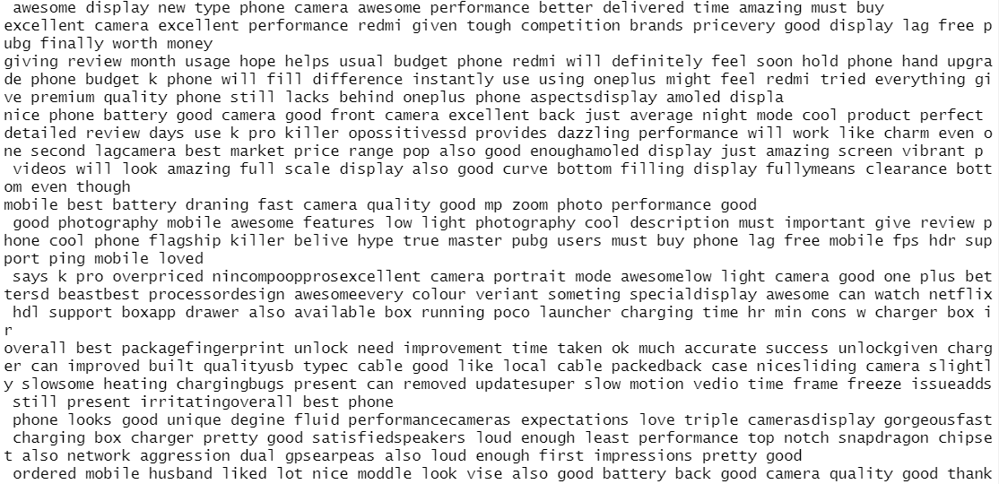
OUTPUT

Slide 11
03
Data Exploration

Slide 12
DTM-MATRIX
#Build a term-document matrix
dtm <- TermDocumentMatrix(docs)
m <- as.matrix(dtm)
v <- sort(rowSums(m),decreasing=TRUE)
d <- data.frame(word = names(v),freq=v)
head(d, 10)

Slide 13
# Tokenise
textdata$Review<-as.character(textdata$Review)
review_tidy <- textdata %>% unnest_tokens(word, Review)
View(textdata)
View(review_tidy)
# Count
review_tidy %>% count(word) %>% arrange(desc(n))
# Remove stop words -
review_tidy2 <- review_tidy %>% anti_join(stop_words)
# Count
word_count<-review_tidy2 %>% count(word) %>% arrange(desc(n))
# Visualization
library(ggplot2)
dev.off()
ggplot(word_count, aes(x = word, y = n)) + geom_col()
# Count
word_count2 <- review_tidy2 %>% count(word) %>% filter(n>100) %>% arrange(desc(n))
ggplot(word_count2, aes(x = word, y = n)) + geom_col() + ggtitle("Word Counts")

Slide 14
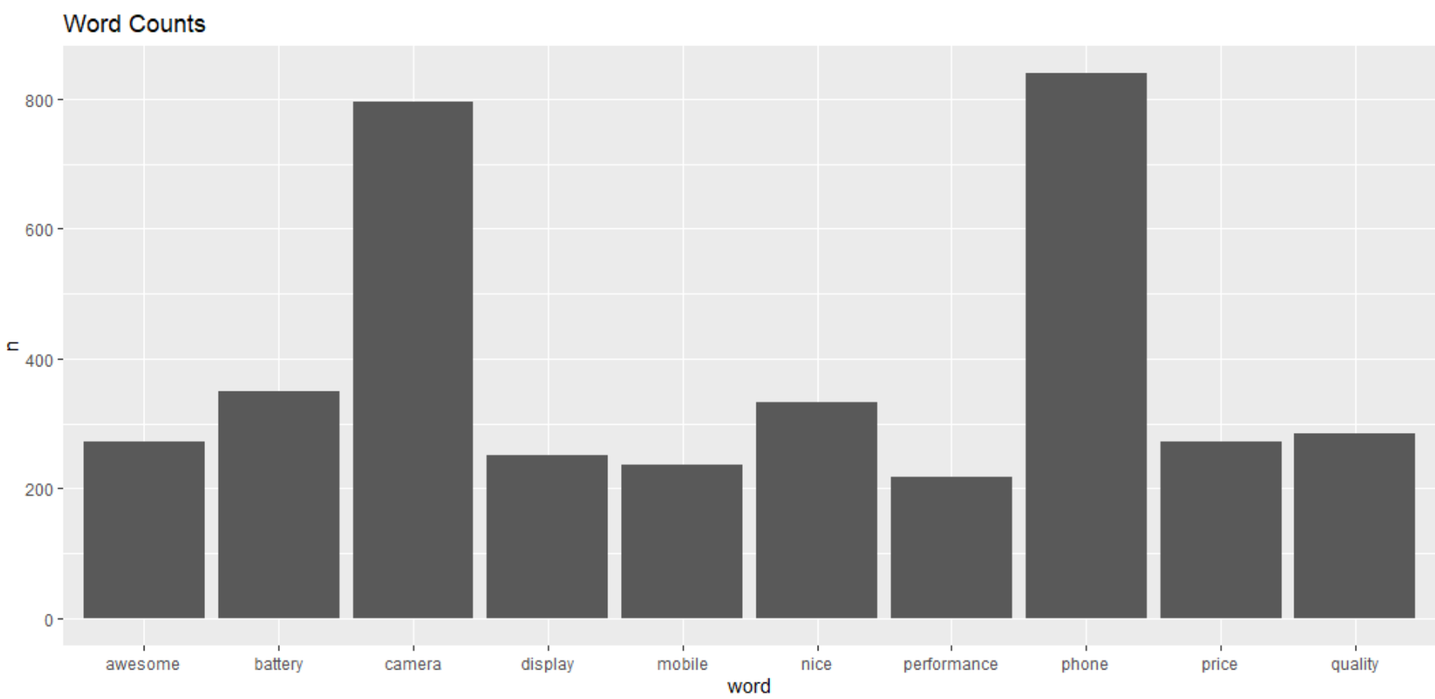

Slide 15
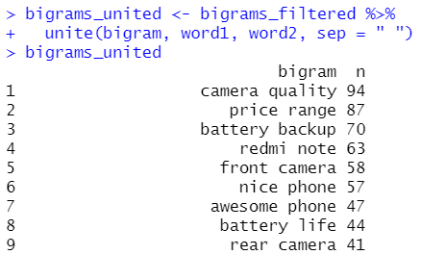
N-GRAMS
textdata<-mutate(textdata,text= as.character(Review))
### deleting stop words
bigrams_separated <- data_bigrams %>%
separate(bigram, c("word1", "word2"), sep = " ")
bigrams_filtered <- bigrams_separated %>%
filter(!word1 %in% stop_words$word) %>%
filter(!word2 %in% stop_words$word)
# new bigram counts:
bigram_counts <- bigrams_filtered %>%
count(word1, word2, sort = TRUE)
bigram_counts
## combine words
bigrams_united <- bigrams_filtered %>%
unite(bigram, word1, word2, sep = " ")

Slide 16
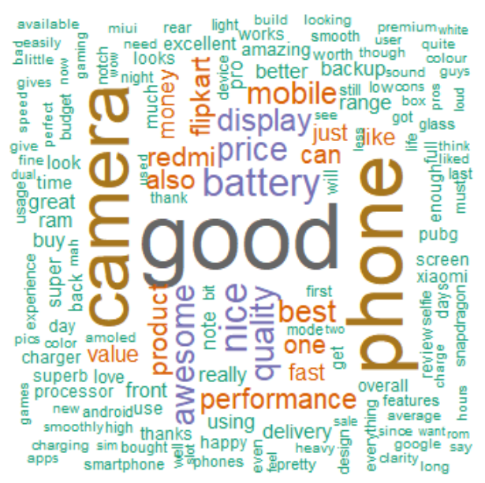
WORD CLOUD
#Generate the Word cloud
set.seed(1234)
wordcloud(words = d$word, freq = d$freq, min.freq = 1,
max.words=200, random.order=FALSE, rot.per=0.35,
colors=brewer.pal(8, "Dark2"))

Slide 17
04
Sentiment Analysis

Slide 18
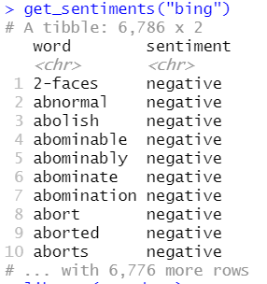
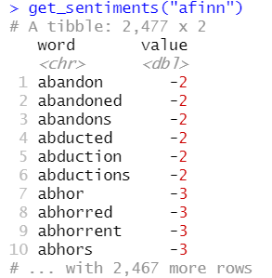
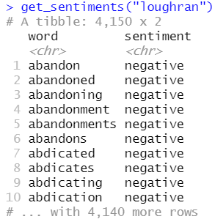
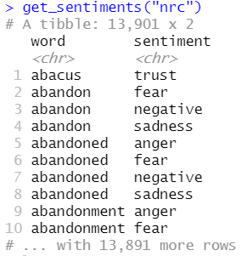
# Using BING(Binary), AFINN(Ordinal), LOUGHRAN(Other meanings), NRC(tidytext) dictionaries
# BING
get_sentiments("bing")
install.packages("textdata")
library(textdata)
get_sentiments("afinn")
get_sentiments("loughran")
get_sentiments("nrc")

Slide 19
# Using BING(Binary), AFINN(Ordinal), LOUGHRAN(Other meanings), NRC(tidytext) dictionaries
# BING
get_sentiments("bing")
install.packages("textdata")
library(textdata)
get_sentiments("afinn")
get_sentiments("loughran")
get_sentiments("nrc")

Slide 20
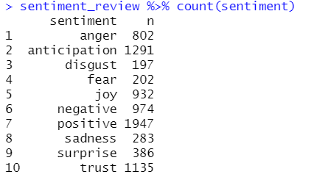
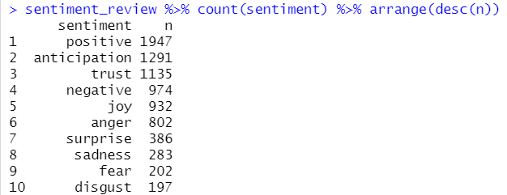
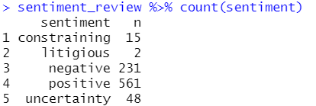


sentiment_review <- review_tidy2 %>% inner_join(get_sentiments("bing"))
sentiment_review %>% count(sentiment)
sentiment_review <- review_tidy2 %>% inner_join(get_sentiments("loughran"))
sentiment_review %>% count(sentiment)
sentiment_review <- review_tidy2 %>% inner_join(get_sentiments("nrc"))
sentiment_review %>% count(sentiment)
sentiment_review %>% count(sentiment) %>% arrange(desc(n))
pos_neg <- sentiment_review %>% count(sentiment) %>% filter(sentiment %in% c("positive", "negative"))
pos_neg

Slide 21
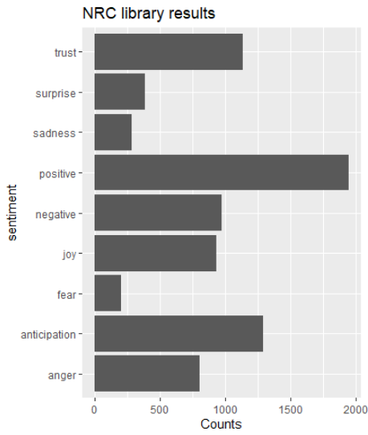
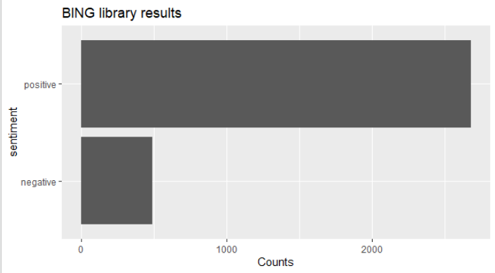
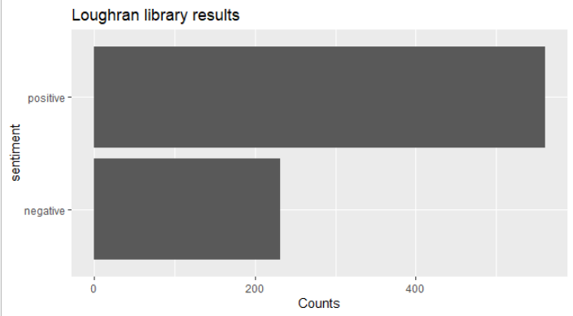
INTERPRETATION
There are mostly positive sentiments in the reviews of MI phones

Slide 22
INSIGHTS
MI phones have overwhelmingly positive reviews from our results that from the lexicon documents we have classified. It is seen that approximately among every 7 reviews, 5 of them are positive and only 2 are negative.
Positive sentiments consisted of multiple features of the product that were mainly focused around the budget (worth, awesome value for price, etc.), camera quality of both the rear and the front facing camera, battery life being good, aesthetically pleasing from words like premium looks, pretty and such, also showed good performance from words like fast for gaming, snapdragon processor, loud audio and regarding build quality using words such as lightweight. Overall, the reviews seemed to indicate that most of the features that a person seeks in a mobile phone were being positively reviewed by the people who wrote the reviews.
From bigrams, we can see that the interpretations drawn reflect the same with high frequency of bigrams namely camera quality, price range,nice/awesome phone and battery life. These reaffirm the interpretations drawn from all of the different techniques and again, there is a majority of positive reviews over negative ones.
Finally, from the NRC graph we can see where the customers are with respect to their emotions. Words such as anticipation, trust and joy are positive whereas some of the negative sentiments were indicated by sadness, fear and anger.

Slide 23
Thank
you…

